Slide 1
Module II- Cloud Enabling Technologies
Dr. Madhukrishna Priyadarsini
Department of CSE
NIT Trichy

Slide 2

Outline:
Broadband Networks and Internet Architecture
Data Center Technology
Virtualization Technology
Web Technology
Multitenant Technology
Service Technology

Slide 3
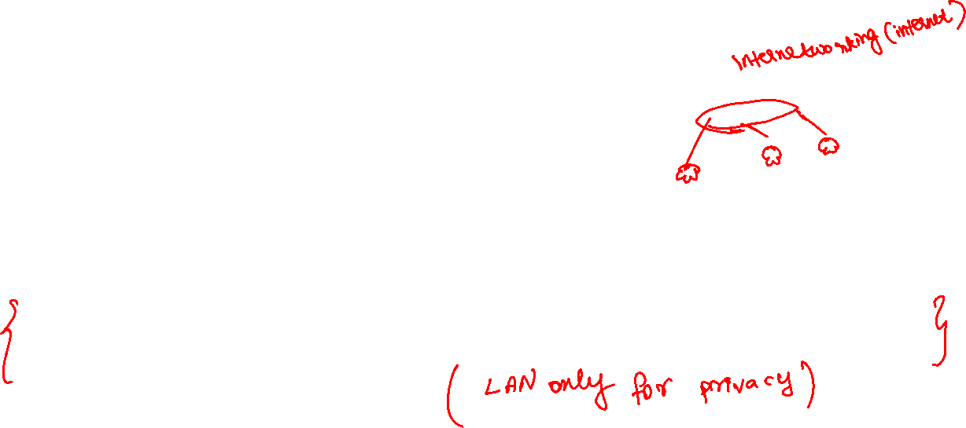
1- Broadband Networks and Internet Architecture
• All clouds must be connected to a network. This inevitable requirement forms an inherent dependency on internetworking.
Internetworks, or the Internet, allow for the remote provisioning of IT resources and are directly supportive of ubiquitous network access (widely accessible).
Cloud consumers have the option of accessing the cloud using only private and dedicated network links in LANs, although most clouds are Internet-enabled.

Slide 4
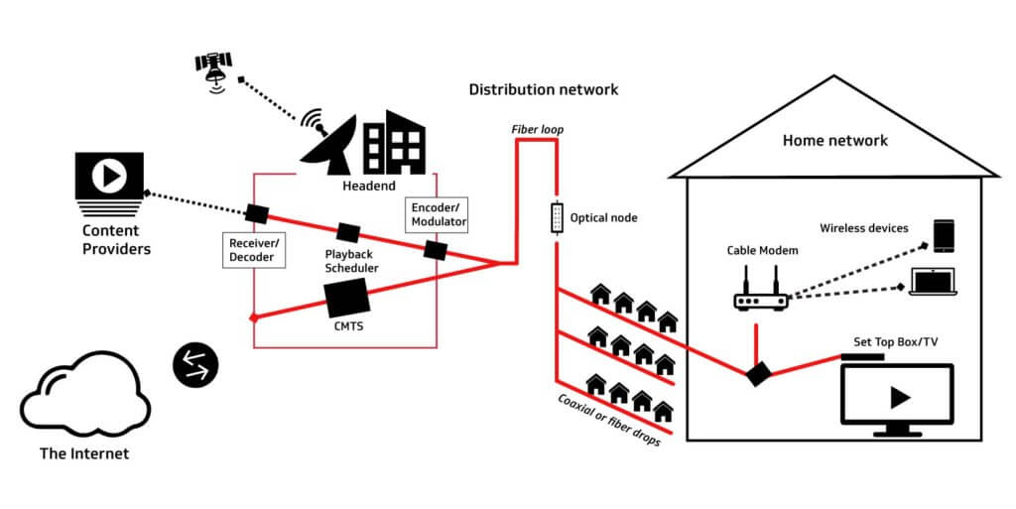

Broadband Networks
Broadband is the transmission of high-quality data of wide bandwidth. In its simplest form, it is a high-speed Internet connection that is always on. Broadband connections include Wi-Fi, DSLs, fiber, and satellites.

Slide 5
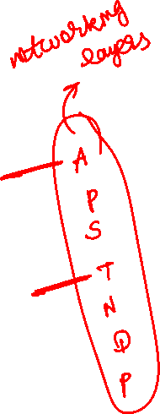
Internet Architecture
The potential of cloud platforms grows in parallel with advancements in Internet connectivity and service quality.
Internet Service Providers (ISPs)
Connectionless Packet Switching (Datagram Networks)
Router-Based Interconnectivity
Physical Network
Transport Layer Protocol
Application Layer Protocol
Technical and Business Considerations
Connectivity Issues
Network Bandwidth and Latency Issues
Cloud Carrier and Cloud Provider Selection

Slide 6
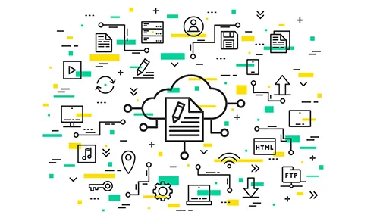
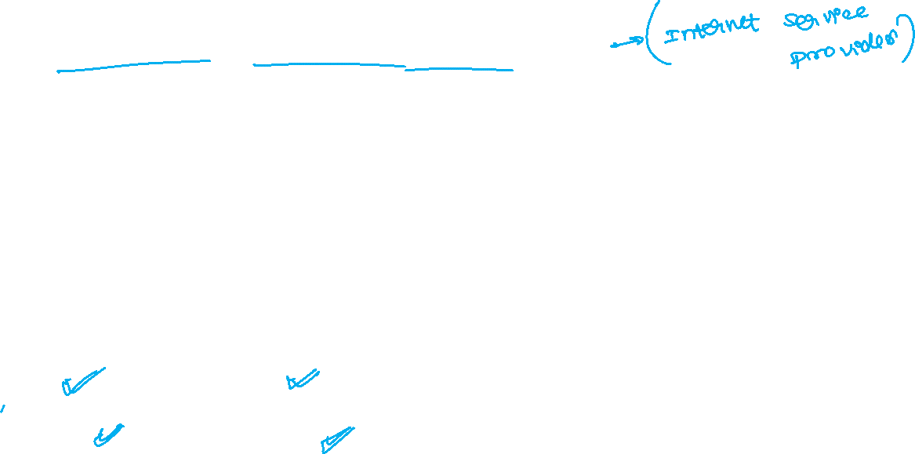
Internet Service Provider (ISP)
ISP is an organization that provides services for accessing, using, and participating in the Internet.
It is organized in different forms;
commercial, community-owned,
non-profit, privately owned etc.
The services provided by ISP are
Internet-access, Internet-transit,
domain-registration, web-hosting etc.

Slide 7
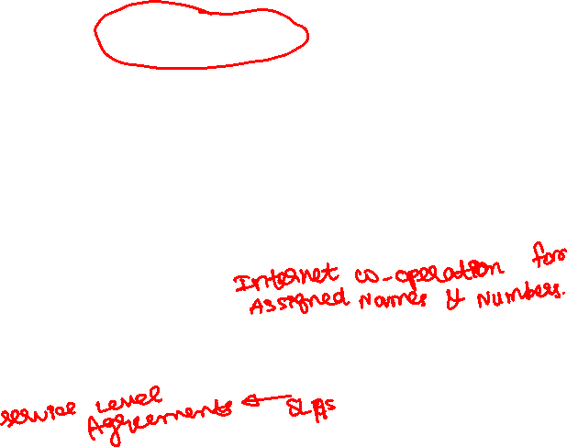
Internet Service Provider (ISP)
Internet’s largest backbone networks are strategically interconnected by core routers that connect the world’s multinational networks.
An ISP network interconnects to other ISP networks and various organizations.
The concept of the Internet was based on a decentralized provisioning and management model.
ISPs can freely deploy, operate, and manage their networks in addition to selecting partner ISPs for interconnection.
No centralized entity comprehensively governs the Internet, although bodies like the Internet Corporation for Assigned Names and Numbers (ICANN) supervise and coordinate Internet communications.
Governmental and regulatory laws dictate the service provisioning conditions for organizations and ISPs both within and outside of national borders.

Slide 8
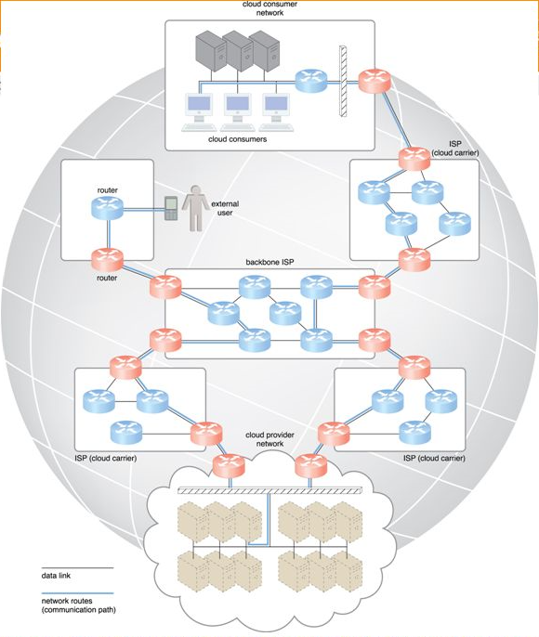
ISP Contd….
(Messages travel over dynamic network routes in the ISP internetworking configuration)

Slide 9
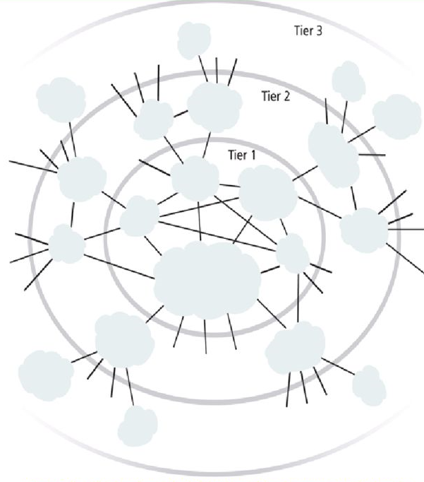
Multi-tier Topology of Internetworking
(An abstraction of the internetworking structure of the Internet)

Slide 10
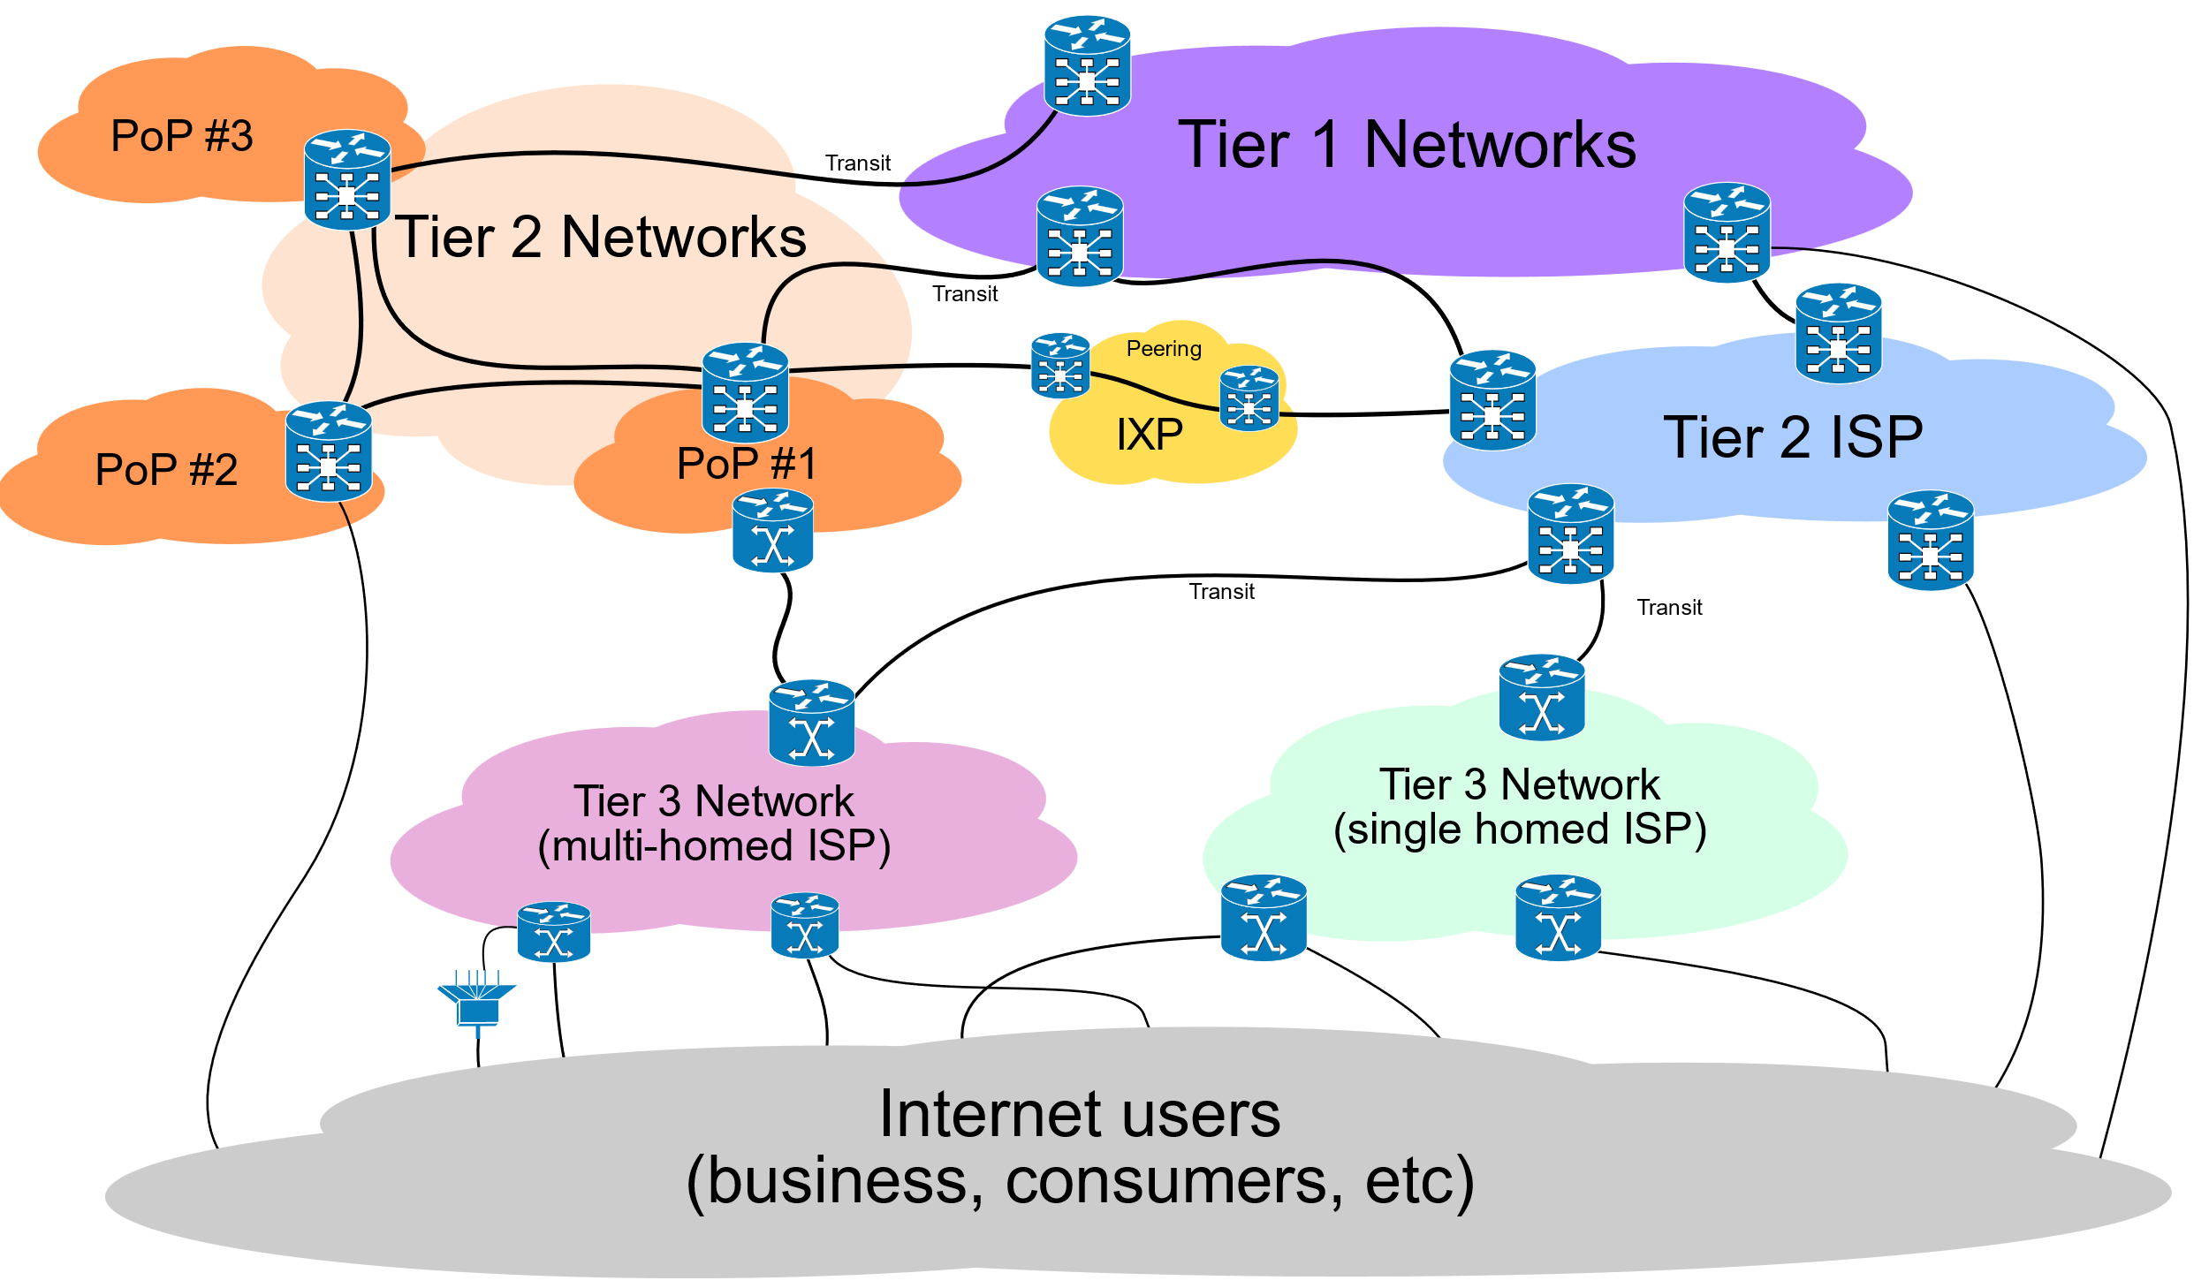
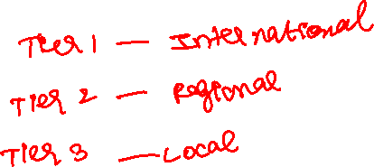
Tiers of ISP
Tier 1- International ISP providers
Tier 2- Regional ISP providers
Tier 3- Local ISP providers

Slide 11
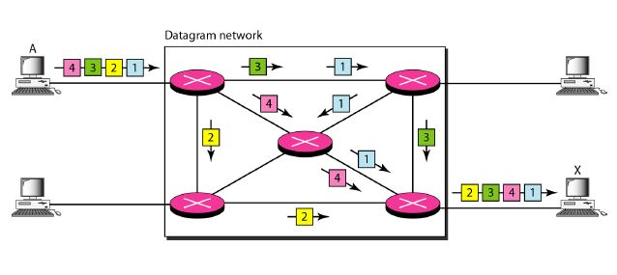
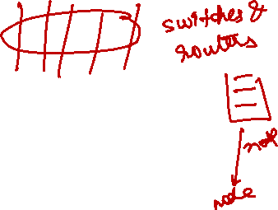

Connectionless Packet Switching
End-to-end (sender-receiver pair) data flows are divided into packets of a limited size that are received and processed through network switches and routers, then queued and forwarded from one intermediary node to the next. Each packet carries location information such as destination IP address, MAC address.
Datagram Networks (datagrams-> smallest unit through which data is transmitted)

Slide 12
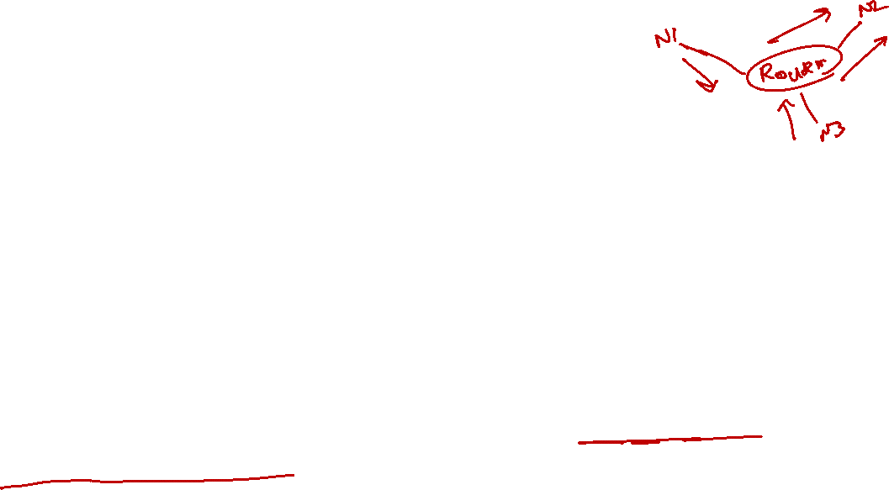
Router-based Interconnectivity
Router is a device that is connected to multiple networks through which it forwards packets.
Routers manage network traffic and gauge the most efficient hop for packet delivery, to both source and destination.
Communication path connects a cloud consumer with its cloud provider may involve multiple ISP networks.
Communication can be sustained even during network failures, using multiple network paths can cause routing fluctuation and latency.

Slide 13
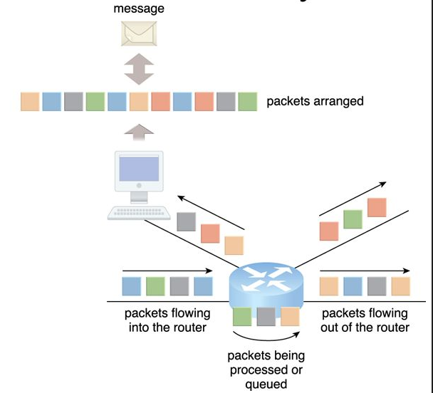
Router-based Interconnectivity Contd….
(Packets traveling through the Internet are directed by a router that arranges them in to a message)

Slide 14
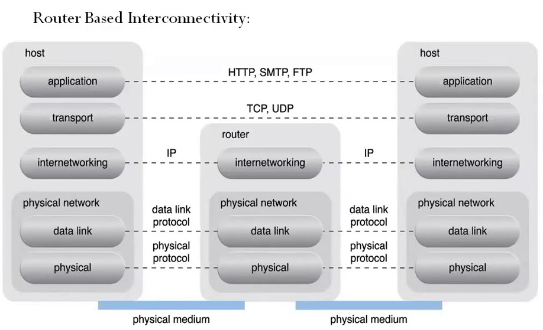
Router-based Interconnectivity Contd….
(A generic view of the Internet reference model and protocol stack)

Slide 15
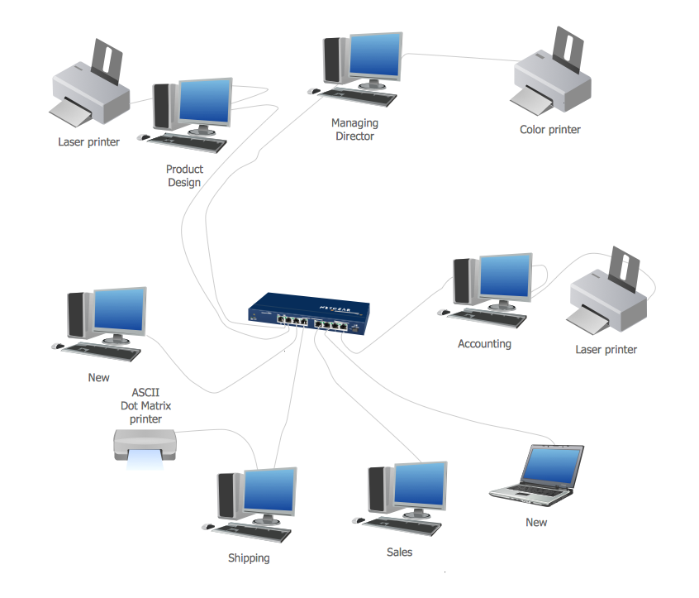
Physical Networks
Physical connection (wired or wireless) between multiple nodes

Slide 16
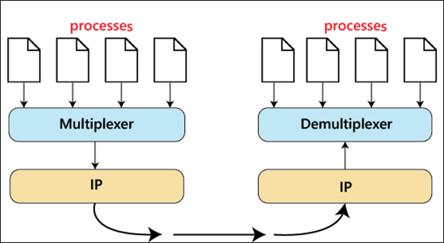
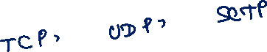
Transport Layer Protocol
TCP, UDP, SCTP

Slide 17
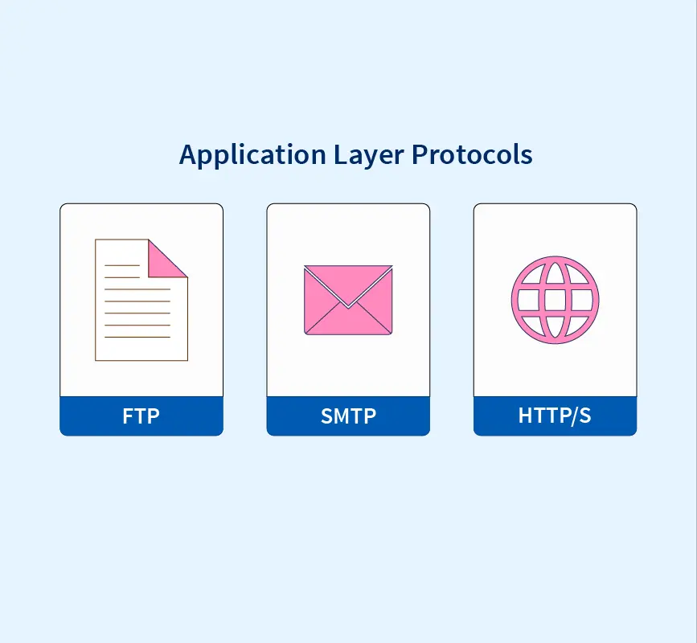
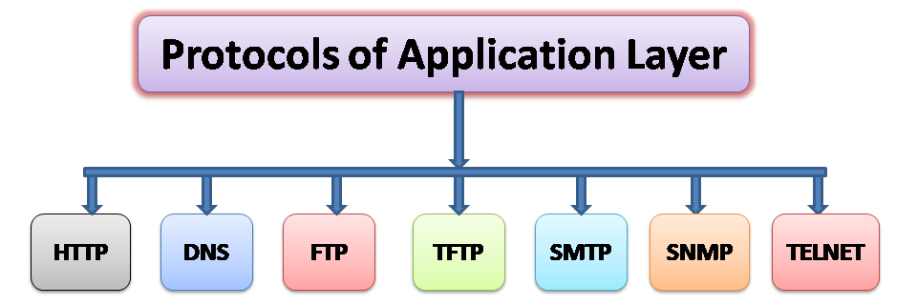
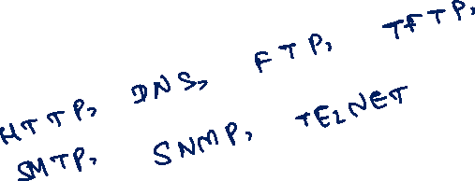
Application Layer Protocol

Slide 18
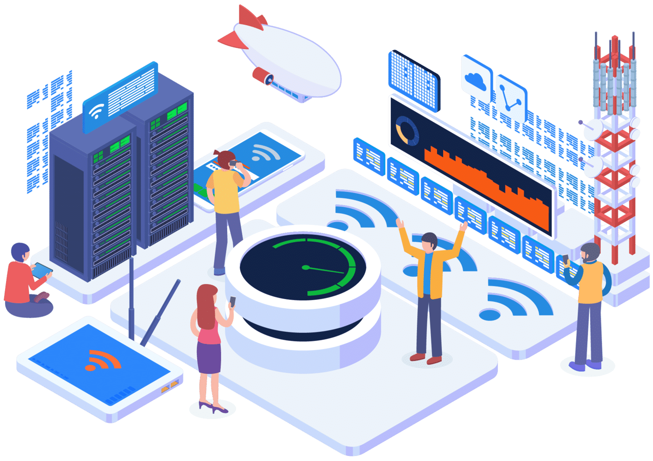
Technical and Business Considerations
Connectivity issues:
An unexpected network failure at one of the network providers that affect the connectivity to the host server.

Slide 19
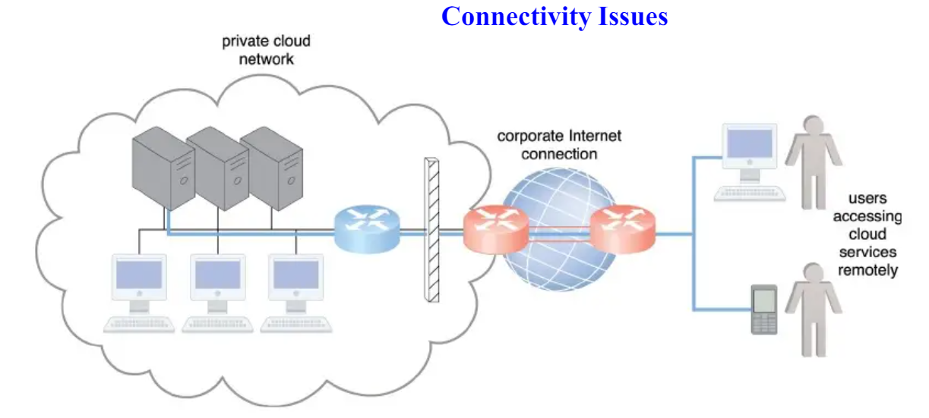
Connectivity Issues Contd…
(The internetworking architecture of a private cloud. The physical IT resources that constitute the cloud are located and managed within the organization)

Slide 20
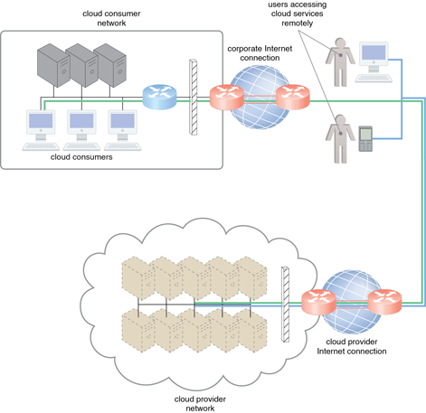
Connectivity Issues Contd…
(The internetworking architecture of an Internet-based cloud deployment model. The Internet is the connecting agent between non-proximate cloud consumers, roaming end-users, and the cloud provider ’s own network)

Slide 21
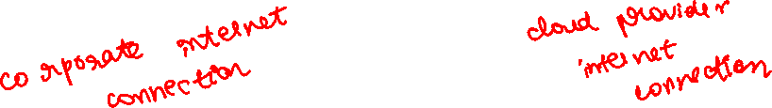
A Comparison of on-premise and Cloud-based Internetworking
On-premise IT Resources | Cloud-based IT Resources
Internal end-user devices access corporate IT services through the corporate network | Internal end-user devices access corporate IT services through an Internet connection
Internal end-user devices access corporate IT services through the corporate Internet connection while roaming in external networks | Internal end-user devices access corporate IT services through the Cloud provider’s Internet connection while roaming in external networks
External end-user devices access corporate IT services through the corporate Internet connection | External end-user devices access corporate IT services through the Cloud provider’s Internet connection

Slide 22
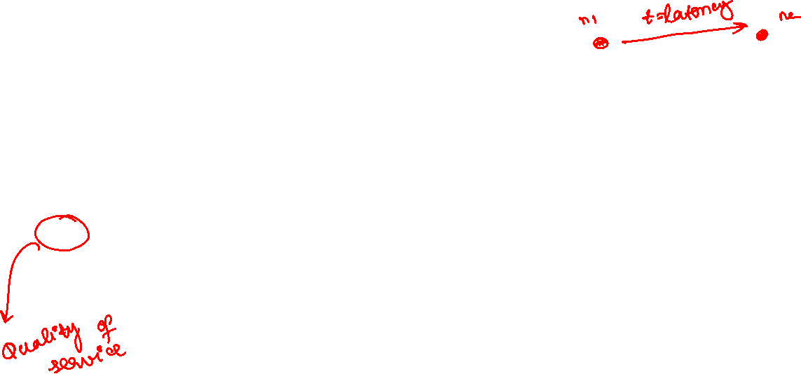
Network Bandwidth and Latency Issues
latency is the amount of time it takes a packet to travel from one data node to another.
Cloud Carrier and Cloud Provider Selection
QoS management across multiple ISPs is difficult to achieve in practice, requiring collaboration of the cloud carriers on both sides to ensure that their end-to-end service levels are sufficient for business requirements.

Slide 23
Cloud Carrier and Cloud Provider Selection
The service levels of Internet connections between Cloud consumers and Cloud providers are determined by their ISPs, which are usually different and therefore include multiple ISP networks in their paths.
Quality of service (QoS) management is across multiple ISPs is difficult to achieve in practice, requiring collaboration of the cloud carriers on both sides to ensure that their end-to-end service levels are sufficient for business requirements.
Cloud consumers and providers may need to use multiple Cloud carriers in order to achieve multiple level of connectivity and reliability for their Cloud applications, resulting in additional cost.
Cloud adoption can therefore be easier for applications with more relaxed latency and bandwidth requirements.

Slide 24
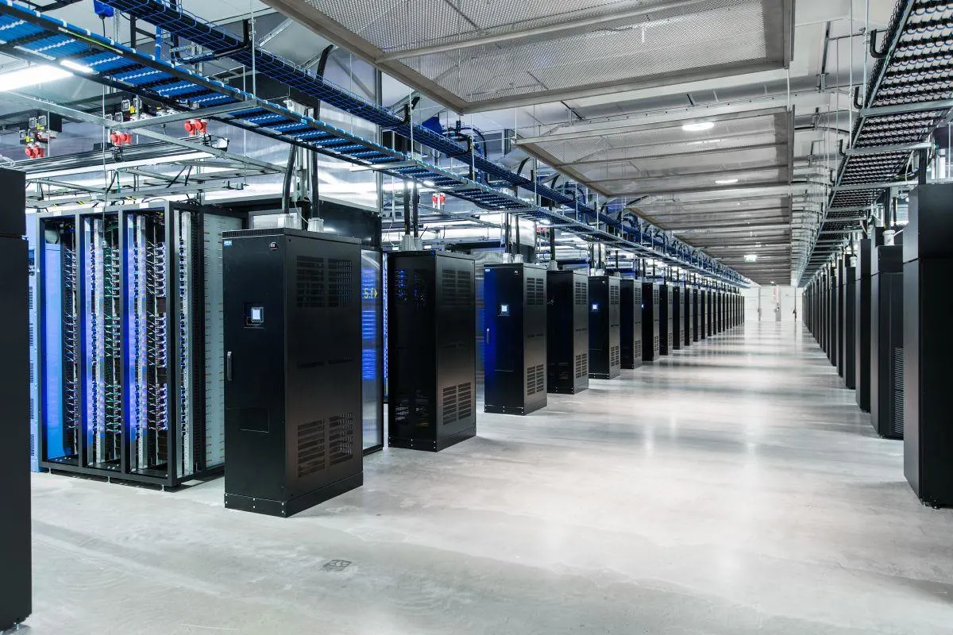
2- Data center Technology
Data centers exist as specialized IT infrastructure used to house centralized IT resources, such as servers, databases, networking and telecommunication devices, and software systems.
Data centers are typically comprised of the following technologies and components:
Virtualization
Standardization and Modularity
Automation
Remote Operation and Management
High Availability
Security-Aware Design, Operation, and Management
Facilities
Computing Hardware
Storage Hardware
Network Hardware
Other considerations

Slide 25
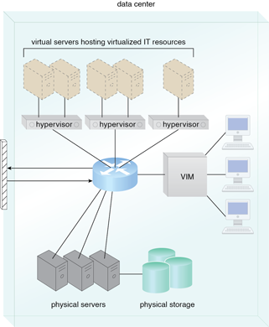

Virtualization
Data centers consist of both physical and
virtualized IT resources.
Virtualized components that are easier to
allocate, operate, release, monitor, and control.
(The common components of a data center working together to provide virtualized IT resources supported by physical IT resources)

Slide 26

Standardization and Modularity
Data centers are built upon standardized commodity hardware (readily available, inexpensive, and easily interchangeable) and designed with modular architectures.
Modularity and standardization are key requirements for reducing investment and operational costs as they enable economies of scale for the procurement, acquisition, deployment, operation, and maintenance processes.
Modular data center consists of modules and components to offer scalable data center capacity with multiple power and cooling options.
Common virtualization strategies and the constantly improving capacity and performance of physical devices.
Consolidated IT resources can serve different systems and be shared among different cloud consumers.

Slide 27
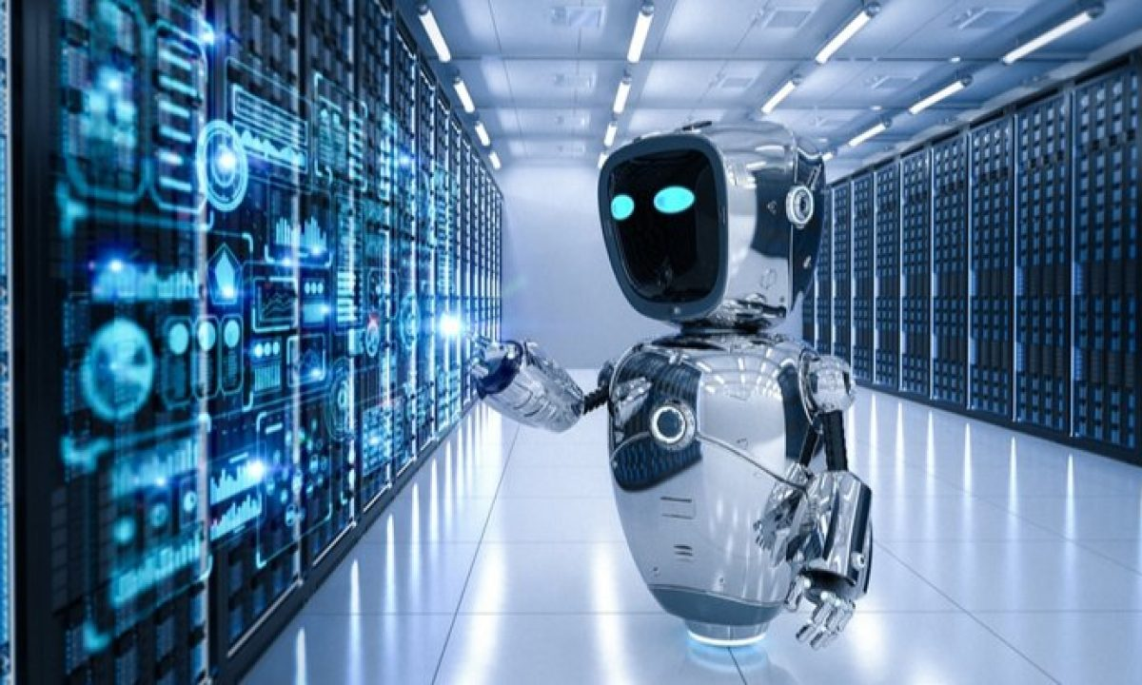

Automation
Data centers have specialized platforms that automate tasks like provisioning, configuration, patching, and monitoring without supervision.
Advances in data center management platforms and tools leverage autonomic computing technologies to enable self-configuration and self-recovery.

Slide 28
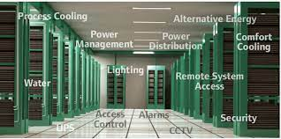
Remote Operation and management
Most of the operational and administrative tasks of IT resources in data centers are commanded through the network’s remote consoles and management systems.
Technical personnel are not required to visit the dedicated rooms that house servers, except to perform highly specific tasks, such as equipment handling and cabling or hardware-level installation and maintenance.

Slide 29
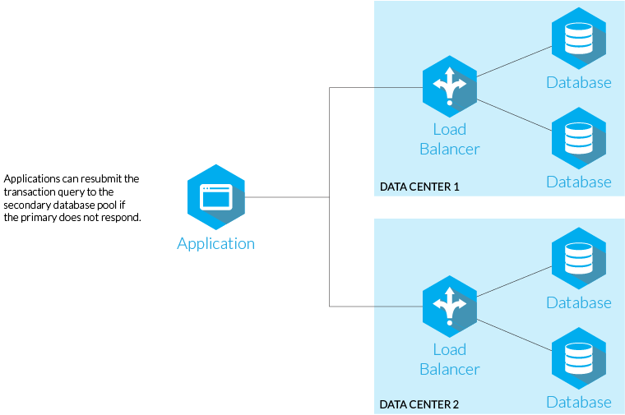
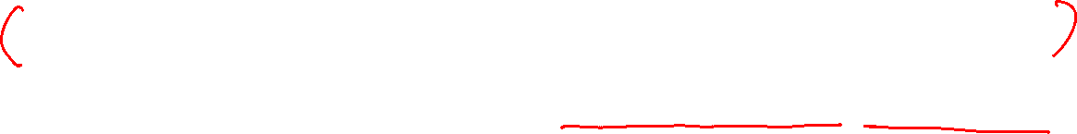
High Availability
High availability is a quality of computing infrastructure that allows it to continue functioning, even when some of its components fails.
Data center outage significantly impacts business continuity for the organizations that use their services, data centers are designed to operate with increasingly higher levels of redundancy to sustain availability.
Data centers usually have redundant, uninterruptable power supplies, cabling, and environmental control subsystems in anticipation of system failure, along with communication links and clustered hardware for load balancing.

Slide 30
Security-Aware Design, Operation, and Management
Physical and logical access controls and data recovery strategies, need to be thorough and comprehensive for data centers, since they are centralized structures that store and process business data.
Outsourcing data center-based IT resources has been a common industry practice for decades.
Outsourcing models often required long-term consumer commitment

Slide 31
Facilities
Data center facilities are custom-designed locations that are outfitted with specialized computing, storage, and network equipment.
Facilities have several functional layout areas, as well as various power supplies, cabling, and environmental control stations that regulate heating, ventilation, air conditioning, fire protection, and other related subsystems.

Slide 32
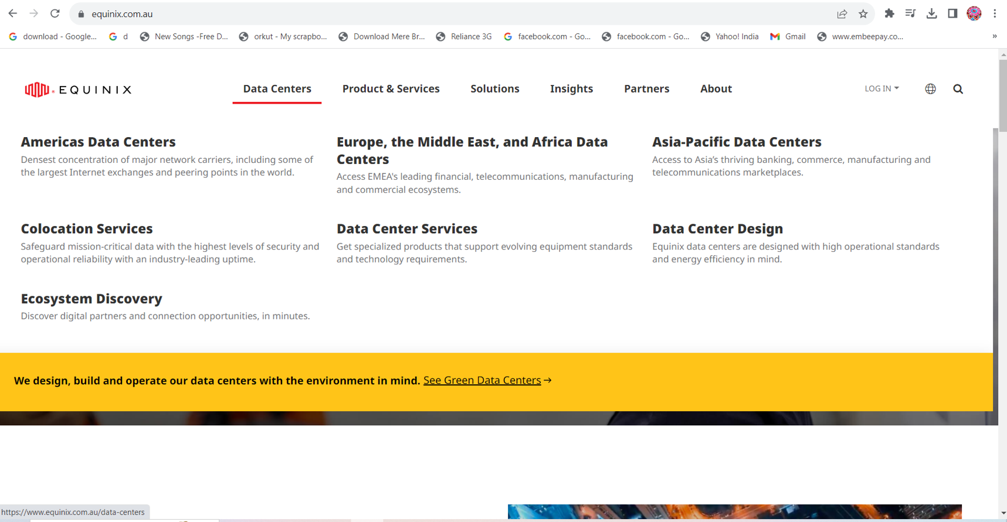
https://www.equinix.com.au/

Slide 33
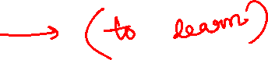
Computing Hardware
Data centers is often executed by standardized commodity servers that have substantial computing power and storage capacity.
Rack mount form factor server design composed of standardized racks with interconnects for power, network, and internal cooling.
Support for different hardware processing architectures, such as x86-32bits, x86-64,and RISC.
A power-efficient multi-core CPU architecture that houses hundreds of processing cores in a space as small as a single unit of standardized racks.
Redundant and hot-swappable components, such as hard disks, power supplies, network interfaces, and storage controller cards.
Computing architectures such as blade server technologies use rack-embedded physical interconnections (blade enclosures), fabrics (switches) and shared power supply units and cooling fans.
The interconnections enhance the inter-component networking and management while optimizing physical space and power.

Slide 34
Storage Hardware
Data centers have specialized storage systems that maintain enormous amounts of digital information in order to fulfill considerable storage capacity needs.
Storage systems are containers housing numerous hard disks that are organized into arrays.
Storage systems usually involve the following technologies:
Hard-disk arrays
I/O caching
Hot-swappable hard disks
Storage specialization
Fast data replication mechanisms
The storage system is connected to one or more IT resources through a network.

Slide 35
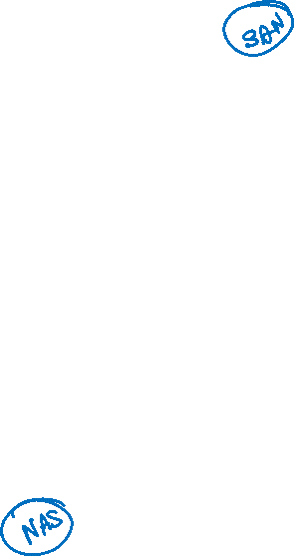

Storage Hardware Contd….
Networked storage devices usually fall into one of the following categories:
Storage Area Network (SAN)-> physical data storage media are connected through a dedicated network and provide block-level data storage access using industry standard protocols such as small computer system interface (SCSI).
Network-Attached Storage (NAS)-> hard drive arrays are contained and managed by this dedicated device, which connects through a network and facilitates access to data using file-centric data access protocols like the network file system (NFS) or server message block (SMB).

Slide 36
Network Hardware
Data centers require extensive network hardware in order to enable multiple levels of connectivity.
Data center is broken down into five network subsystems:
Carrier and External Networks Interconnection-> a subsystem related to the internetworking infrastructure, this interconnection is usually comprised of backbone routers that provide routing between external WAN connections and data center’s LAN, as well as perimeter network security devices such as Firewalls and VPN Gateways.
Web-Tier Load Balancing and Acceleration-> this subsystem comprises Web acceleration devices, such as XML-preprocessors, encryption/decryption appliances, layer 7 switching devices that perform content-aware routing.
LAN Fabric-> constitutes internal LAN and provides high performance and redundant connectivity for all the data center network-enabled IT resources. It is implemented with multiple network switches using virtualization functions, LAN aggregation, load balancing etc.
SAN Fabric-> provides a connectivity between servers and storage systems, and implemented with fibre channel, fibre channel with ethernet, infiBand network switches.
NAS Gateways-> supplies attachment points for NAS-based storage devices and implements protocol conversion hardware that facilitates data transmission between SAN and NAS devices.

Slide 37
Other Considerations
IT hardware is subject to rapid technological obsolescence, with lifecycles that typically last between five to seven years.
Security is another major issue when considering the role of the data center and the vast quantities of data contained within its doors.

Slide 38
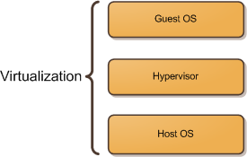




3- Virtualization Technology
Virtualization is the process of converting a physical IT resource into a virtual IT resource.
Most types of IT resources can be virtualized, including:
Servers- A physical server can be abstracted into a virtual server.
Storage- A physical storage device can be abstracted into a virtual storage device or a virtual disk
Network- Physical routers and switches can be abstracted into logical network fabrics, such as VLANs.
Power- A physical UPS and power distribution units can be abstracted into what are commonly referred to as virtual UPSs.

Slide 39
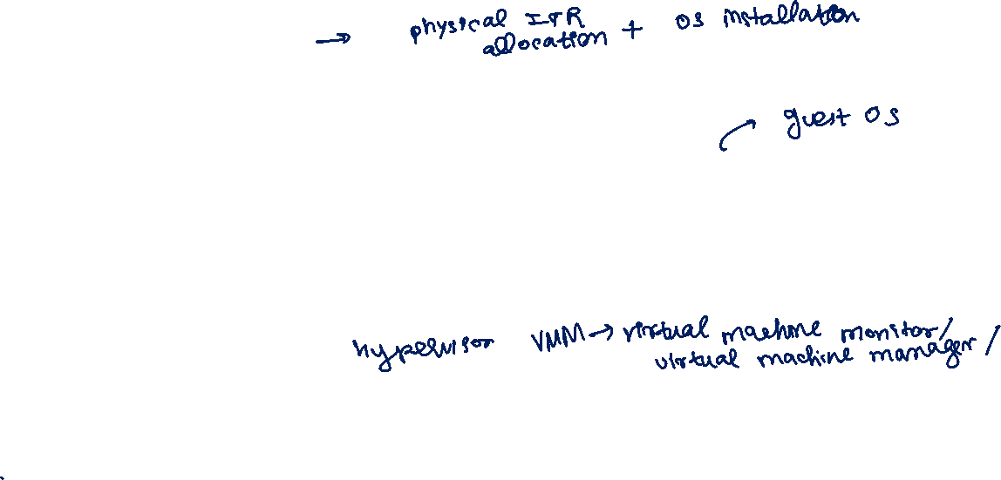
Virtualization Technology Contd…
Using the server virtualization technology the creation and the deployment of virtual servers are done.
Creation of Virtual Servers:
Step-1: Allocation of physical IT resources followed by the installation of an operating system using virtualization software (hypervisor).
Step-2: Virtual servers use their own guest operating systems, which are independent of the operating system in which they were created.
Deployment of Virtual Servers:
Step-1: Virtualization software runs on a physical server called a host or physical host, whose underlying hardware is made accessible through the virtualization software.
Step-2: The virtualization software functionality encompasses system services that are specifically related virtual machine management and not normally found on standard operating systems. This software is referred to as a virtual machine monitor or virtual machine manager (VMM) or hypervisor.

Slide 40
Virtualization comprises of the following technologies:
Hardware Independence
Server Consolidation
Resource Replication
Hardware-based and OS-based Virtualization
Virtualization Operation and Management
Technical and Business Consideration

Slide 41
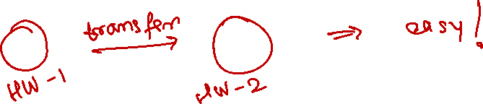
Hardware Independence
Virtualization is a conversion process that translates unique IT hardware in to emulated and standardized software-based copies.
Virtual servers can easily be moved to another virtualization host, automatically resolving multiple hardware-software incompatibility issues.
Cloning and manipulating virtual IT resources is much easier than duplicating physical hardware.

Slide 42
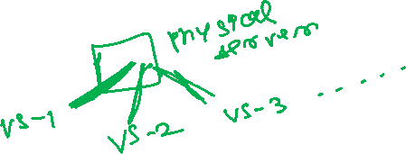
Server Consolidation
The coordination function that is provided by the virtualization software allows multiple virtual servers to be simultaneously created in the same virtualization host.
Enables different virtual servers to share one physical server.
Is commonly used to increase hardware utilization, load balancing, and optimization of available IT resources.
Is fundamental capability directly supports common cloud features, such as on-demand usage, resource pooling, elasticity, scalability, and resiliency.

Slide 43
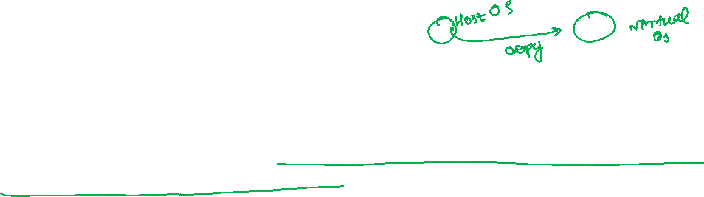
Resource Replication
Virtual servers are created as virtual disk images that contain binary file copies of hard disk content.
Virtual disk images are accessible to the host’s operating system, meaning simple file operations, such as copy, move, and paste, can be used to replicate, migrate, and back up the virtual server.
Resource replication is one of the salient features of virtualization technology
Features
The creation of standardized virtual machine images gives increase agility in the migration and deployment of a virtual machine’s new instances.
The ability to roll back
The support of business continuity with efficient back up and restoration procedures.

Slide 44
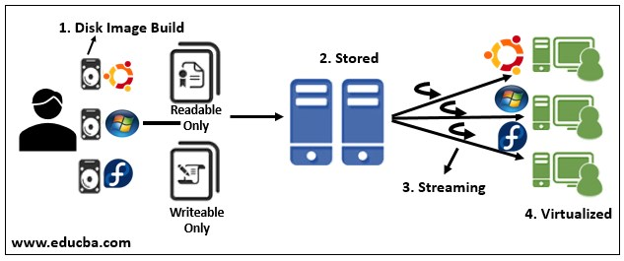
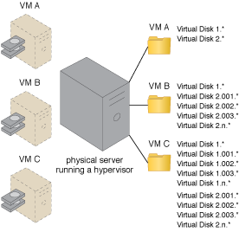
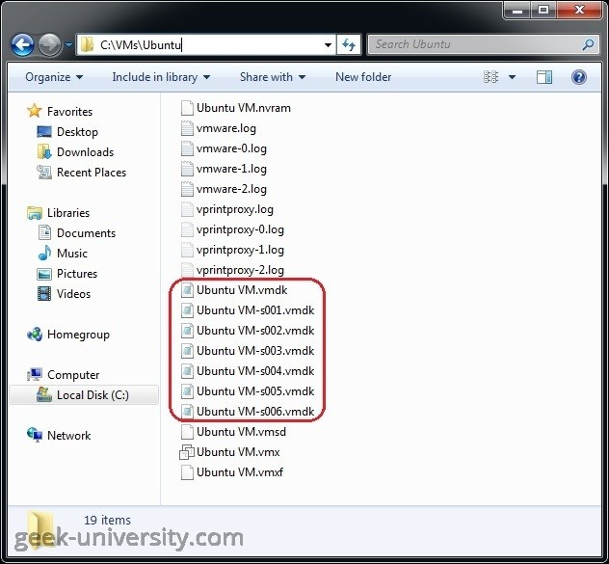

Slide 45
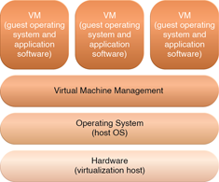
Operating System-based Virtualization
OS-based virtualization is the installation of virtualization software in a pre-existing OS which is called the host OS.
Hardware independence is that is enabled by virtualization allows hardware IT resources to be more flexibly used.

Slide 46
OS-based Virtualization Contd…
Virtualization software translates hardware IT resources that require unique
software for operation into virtualized IT resources that are compatible with a range of operating systems.
System-based virtualization is the processing overhead required to run the virtualization software and host operating systems.
Estimating, monitoring, and managing the resulting impact can be challenging because it requires expertise in system workloads, software and hardware environments, and sophisticated monitoring tools.
Examples of such services include:
Backup and recovery
Integration and directory services
Security management

Slide 47
OS-based Virtualization Contd…
OS-based virtualization can introduce demands and issues related to performance overhead such as;
The host OS consumes CPU, memory, and other hardware IT resources.
Hardware-related calls from guest OS need to traverse several layers to and from the hardware which decreases overall performance.
Licenses are usually required for host OS, in addition to individual licenses for each of their guest OS.

Slide 48
Hardware-based Virtualization
Represents the installation of virtualization software directly on the physical host hardware so as to bypass the host operating system.
Allowing the virtual servers to interact with hardware without requiring intermediary action from the host operating system generally makes hardware-based virtualization more efficient.
Virtualization software is typically referred to as a hypervisor for this type of
processing.
A hypervisor has a simple user-interface that requires a negligible amount of storage space.
Main issues of hardware-based virtualization concerns compatibility with hardware devices.

Slide 49
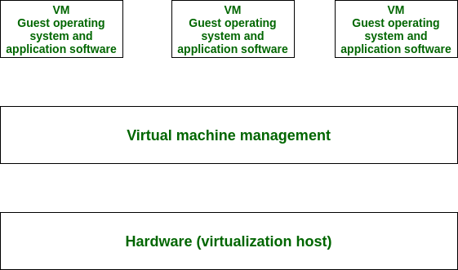
Hardware-based Virtualization Contd…

Slide 50
Virtualization Management
Modern virtualization software provides several advanced management functions that can automate administration tasks and reduce the overall operational burden on virtualized IT resources.
Virtualized IT resource management is often supported by virtualization infrastructure management (VIM) tools that collectively manage virtual IT resources and rely on a centralized management module.

Slide 51
Technical and Business Considerations
Performance Overhead–Virtualization may not be ideal for complex systems that have high workloads with little use for resource sharing and replication.
Special Hardware Compatibility–Many hardware vendors that distribute specialized hardware may not have device driver versions that are compatible with virtualization software.
Portability–The programmatic and management interfaces that establish administration environments for a virtualization program to operate with various virtualization solutions can introduce portability gaps due to incompatibilities. Initiatives such as Open Virtualization Format (OVF) for the standardization of virtual disk image formats are dedicated to alleviating this concern.

Slide 52
4- Web Technology
Cloud computing’s fundamental reliance on internetworking, Web browser universality, and the ease of Web-based service development.
Web technology is generally used as both the implementation medium and the management interface for cloud services.
Web Technology refers to the means by which computers communicate with each other using markup languages and multimedia packages.
Basic Technology:
Uniform Resource Locator (URL)
Hypertext Transfer Protocol (HTTP)
Markup Language (HTMP, XML)
Web Applications:
Presentation layer (user interface)
Application layer (application logic in application server)
Data layer (data store in data server)

Slide 53
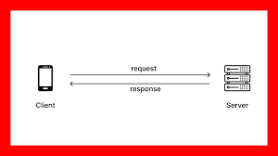
Basic Web technology
The WWW is a system of interlinked IT resources that are accessed through the Internet.
The two basic components of the Web are the web browser client and the web server.
Other components such as proxies, caching services, gateways, and load balancers are used to improve the web application characteristics such as scalability and security.
The additional technologies reside in a layered architecture that is positioned between the client and the server.

Slide 54
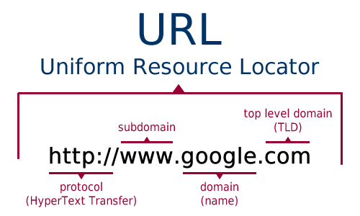


Uniform Resource Locator (URL)
URL is a standard syntax used for creating identifiers that point to web-based resources, the URL is often structured using a logical network connection.

Slide 55
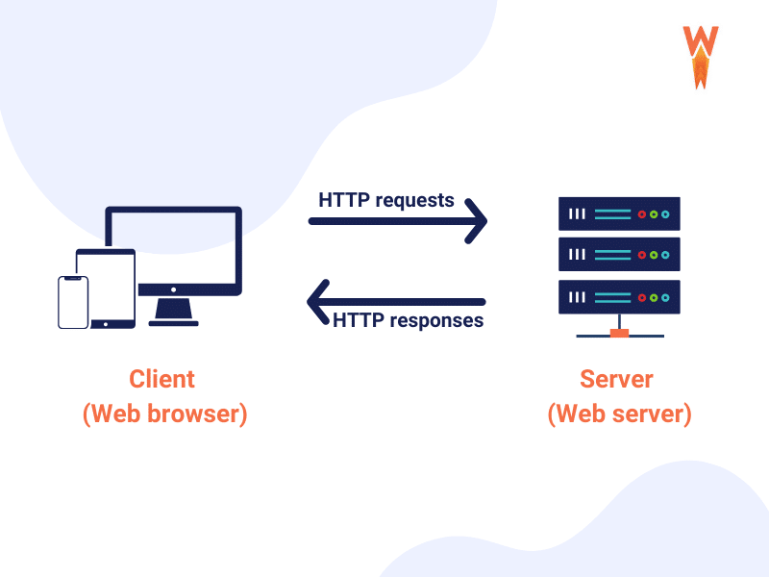
Hypertext Transfer Protocol (HTTP)
HTTP is the primary communication protocol used to exchange content and data through WWW.
The URLs are transmitted using HTTP.

Slide 56
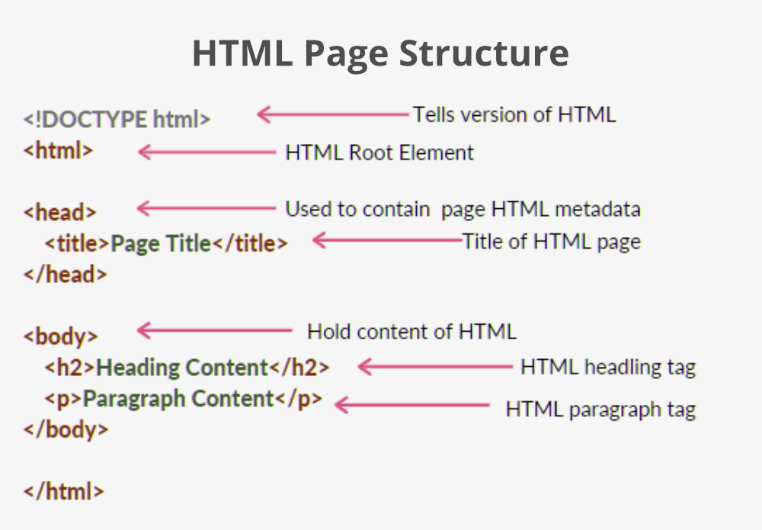
Markup Languages
Markup languages (HTML, XML) provide a lightweight means of expressing web-centric data and meta data.
HTML is used to express the presentation of web pages.

Slide 57
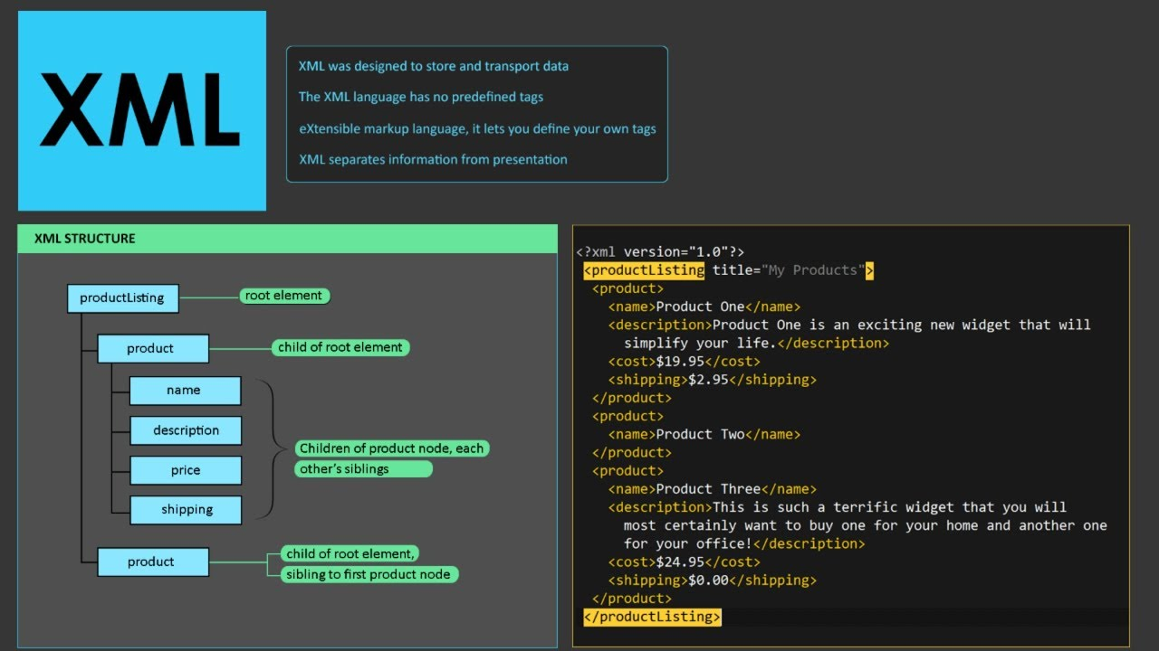

Markup Languages Contd…
XML allows for the definition of vocabularies used to associate meaning to web-based data via meta data.

Slide 58

Web Applications
Applications running on a web browser rely on the web browser for the presentation of user interfaces.
(Architectural abstraction for web applications using the three-tier model)

Slide 59
Web Applications Contd….
The presentation layer has components on both the client and the server side.
Web servers receive client-requests and retrieve requested resources directly as static web content and indirectly as dynamic web content, which is generated according to the application logic.
Web servers interact with application servers in order to execute the requested application logic, which then typically involves interaction with one or more underlying databases.
PaaS ready-made environments enable cloud consumers to develop and deploy web applications.
Typical PaaS offerings have separate instances of the web servers, application servers, and data storage server environments.

Slide 60

5- Multitenant Technology
The multitenant application design was created to enable multiple users(tenants) to access the same application logic simultaneously.
Each tenant has its own view of the application that it uses, administers, and customizes as a dedicated instance of the software while remaining unaware of other tenants that are using the same application.

Slide 61
Multitenant applications ensure that tenants do not have access to data and configuration information that is not their own.
Tenants can individually customize features of the application, such as:
User Interface – Tenants can define a specialized “look and feel” for their application interface.
Business Process – Tenants can customize the rules, logic, and workflows of the business processes that are implemented in the application.
Data Model – Tenants can extend the data schema of the application to include, exclude, or rename fields in the application data structures.
Access Control – Tenants can independently control the access rights for users and groups.
Multitenant application architecture is often significantly more complex than that of single-tenant applications.

Slide 62
Common characteristics of multitenant applications include:
Usage Isolation – The usage behavior of one tenant does not affect the application availability and performance of other tenants.
Data Security – Tenants cannot access data that belongs to other tenants.
Recovery – Backup and restore procedures are separately executed for the data of each tenant.
Application Upgrades – Tenants are not negatively affected by the synchronous upgrading of shared software artifacts.
Scalability – The application can scale to accommodate increases in usage by existing tenants and/or increases in the number of tenants.
Metered Usage – Tenants are charged only for the application processing and features that are actually consumed.
Data Tier Isolation – Tenants can have individual databases, tables, and/or schemas isolated from other tenants.

Slide 63

(A multitenant application that is serving multiple cloud service consumers simultaneously)

Slide 64
Multitenancy Vs. Virtualization
Multitenancy is sometimes mistaken for virtualization because the concept of multiple tenants is similar to the concept of virtualized instances.
The differences lie in what is multiplied within a physical server acting as a host:
With virtualization: Multiple virtual copies of the server environment can be hosted by a single physical server. Each copy can be provided to different users, can be configured independently, and can contain its own operating systems and applications.
With multitenancy: A physical or virtual server hosting an application is designed to allow usage by multiple different users. Each user feels as though they have exclusive usage of the application.

Slide 65
6- Service Technology
Service technology is a software that assists customer service teams in achieving customer success.
These tools improve workflow efficiency and make it easier for companies to provide effective solutions to their customers.
Service technology is a keystone foundation of cloud computing that formed the basis of the “as-a-service” cloud delivery models.
Several service technologies are used to realize and build upon cloud based environments are:
Web Services
REST Services
Service Agents
Service Middleware

Slide 66



Web Services
Web Service Description Language (WSDL) – This markup language is used to create a WSDL definition that defines the application programming interface (API)of a Web service.

Slide 67



XML Schema Definition Language (XML Schema) – Messages exchanged by Web services must be expressed using XML.
XML schema describes the structure of the XML document.
The XML schema language is also referred to as XML schema definition (XSD).
SOAP – Formerly known as the Simple Object Access Protocol, this standard defines a common messaging format used for request and response messages exchanged by Web services.

Slide 68

Universal Description, Discovery, and Integration (UDDI) – This standard regulates service registries in which WSDL definitions can be published as part of a service catalog for discovery purposes.

Slide 69


Slide 70
REST (Representational State Transfer) Services
REST is a software architectural style that was created to guide the design and development of the architecture for the World Wide Web.
REST defines a set of constraints for how the architecture of an Internet-scale distributed hypermedia system, such as the Web, should behave.
REST services are designed according to a set of constraints that shape the service architecture to emulate the properties of the World Wide Web.
REST services do not have individual technical interfaces but instead share a common technical interface that is known as the uniform contract, which is typically established via the use of HTTP methods.
The six REST design constraints are:
Client-Server
Stateless
Cache
Interface/Uniform Contract
Layered System
Code-On-Demand

Slide 71

Client-Server is a major constraint and it simply requires the existence of a client component that sends request and a server component that receives requests.
After receiving the request, the server may also issue a response to the clients.
The constraint is based on the principle of separation of concerns.
Separation of concerns:
Separates user interface concerns from data storage concerns.
Separates portability of interface across multiple platforms.
Improves scalability by simplifying server components.
Allows the components to evolve independently.

Slide 72

Stateless is defined from the perspective of a server.
The server should not remember the state of the application.
As a consequence, the client should send all necessary information for execution along with each request packet, because the server can not reuse the information from the previous request packet as it did not memorize them.
All information needed is present in the message itself.

Slide 73
By applying statelessness constraint:
Session state is kept entirely on the client.
Visibility is improved since a monitoring system does not have to look beyond a single request.
Reliability is improved due to easier recoverability from partial failures.
Scalability is improved due to not having to allocate resources for storing state.
The server does not have to manage resource usages across requests.

Slide 74
Cache:
REST includes cache constraints so that the second fetch does not have to be made at all.
If data can be designed in such a way to take advantage of this, we can reduce total network traffic by orders of magnitude.
By adding optional non-shared caching:
Data within a response to a request will be implicitly and explicitly labeled as cacheable or non-cacheable.
If a response is cacheable, then the client cache is given a right to reuse that response data for later equivalent requests.
Improves scalability, efficiency, and user-perceived performance.
Tradeoff: Cacheable constraint reduces reliability.

Slide 75

Uniform Interface:
This constraint states that the interface for a component needs to be as generic as possible.
It simplifies and decouples the architecture, which enables each part of the architecture to evolve independently.
By applying uniform interface constraint:
The overall system architecture is simplified and the visibility of interaction is improved.

Slide 76
Implementations are decoupled from the services they provide and encourage independent evolvability.
Tradeoff: Degrades efficiency since information is transformed in a standardized form rather than one which is specific to application’s needs.
Further, a uniform interface has four sub-constraints
Identification of resources.
Manipulation of resources through representations.
Self-descriptive messages.
Hypermedia as the engine of application state

Slide 77

Layered System
There are many layers between the client and the server.
These are called intermediaries and can be added in various points in the request response path without changing the interfaces between the components, where they do things to passing messages such as translation or improving performance with caching.

Slide 78
Intermediaries include proxies and gateways.
Proxies are chosen by the client, and gateways are chosen by the origin server or are imposed by the network.
By applying a layered system constraint:
Similar to client-server constraint, this constraint improves simplicity by separating concerns.
Can be used to encapsulate legacy services or protect new services from legacy clients.
Intermediaries can be used to improve system scalability by enabling load balancing.
Placing shared caches at boundaries of the organizational domain can result in significant benefits. Can also enforce security policies e.g. firewall.
Intermediaries can actively transform message content since messages are self-descriptive and their semantics are visible to the intermediaries.
Tradeoff: Adds overhead and latency and reduce user-perceived performance.

Slide 79

Code on demand:
The code on demand is an optional constraint. It allows the client to download and execute a code from the server.
By applying code on demand constraint:
Simplifies clients, hence promote the reduced coupling features.
Improves scalability by virtue of the server offloading work onto the clients.
Tradeoff: reduces visibility generated by the code itself, which is hard for an intermediary to interpret.

Slide 80
Service Agents
Service agents are event-driven programs designed to intercept messages at runtime.
There are active and passive service agents.
Active service agents perform an action upon intercepting and reading the contents of a message.
Passive service agents, on the other hand, do not change message contents.
Cloud-based environments rely heavily on the use of system-level and custom service agents to perform much of the runtime monitoring and measuring required to ensure that features (elastic scaling and pay-for-use billing) can be carried out instantaneously.

Slide 81
Middleware services
Middleware platforms that evolved from messaging-oriented middleware(MOM) platforms used primarily to facilitate integration, to sophisticated service middleware platforms designed to accommodate complex service compositions.
Two most common types of middleware platforms relevant to services computing are
Enterprise service bus (ESB): encompasses a range of intermediary processing features, including service brokerage, routing, and message queuing.
Orchestration platform: environments are designed to host and execute workflow logic that drives the runtime composition of services.

Slide 82
Summary
Cloud consumers and cloud providers typically use the Internet to communicate, which is based on a decentralized provisioning and management model and is not controlled by any centralized entities.
The main components of internetworking architecture are connectionless packet switching and router-based interconnectivity, which use network routers and switches.
Network bandwidth and latency are characteristics that influence QoS, which is heavily impacted by network congestion.
A data center is a specialized IT infrastructure that houses centralized IT resources, such as servers, databases, and software systems.
Data center IT hardware is typically comprised of standardized commodity servers of increased computing power and storage capacity, while storage system technologies include disk arrays and storage virtualization.
Technologies used to increase storage capacity include DAS, SAN, and NAS.

Slide 83
Summary Contd….
Computing hardware technologies include rack mounted server arrays and multi-core CPU architectures, while specialized high-capacity network hardware and technology, such as content-aware routing, LAN and SAN fabrics, and NAS gateways, are used to improve network connectivity.
Server virtualization is the process of abstracting IT hardware into virtual servers using virtualization software.
Virtualization provides hardware independence, server consolidation, and resource replication, and further supports resource pooling and elastic scalability.
Virtual servers are realized through either operating system-based or hardware- based virtualization.
Web technology is very commonly used for cloud service implementations and for front-ends used to remotely manage cloud-based IT resources.
Fundamental technologies of Web architecture include the URL, HTTP,HTML, and XML

Slide 84
Summary Contd….
Web-based services, such as Web services and REST services, rely on non-proprietary communications and technical interface definitions to establish standardized communications frameworks based on Web technology.
Service agents provide event-driven runtime processing that can be applied to numerous functional areas within clouds. Many are deployed automatically as part of operating systems and cloud-based products.
Service middleware, such as ESBs and orchestration platforms, can be deployed on clouds.

Slide 85
Sample QP
Questions based on Remembering, Understanding, and Application
Define REST and its working?
Define the role of web services in cloud technologies?
Distinguish physical and virtual servers?
Demonstrate the need of virtualization in a multi-core processor with an example?
Infer Virtual Machine Monitor (VMM)?
Summarize the difference between hardware-level security and OS-level security?
Differentiate multi-tasking, multi-threading, and virtualization?
Compare and contrast on Grid and Cloud?
What are Cyber-Physical systems?
Enhance cloud services as cluster-as-a-service?

Slide 86

Questions based on Creation
Explain how virtualized cloud will serve the service requests from the below shown networks?

Slide 87

In the network given below, how different cloud technologies are applied, explain in details?

Slide 88
Questions based on Design
Suppose you are designing Virtual Data Centre. What key elements you need? Draw the Block Diagram for it.

